Slide 1
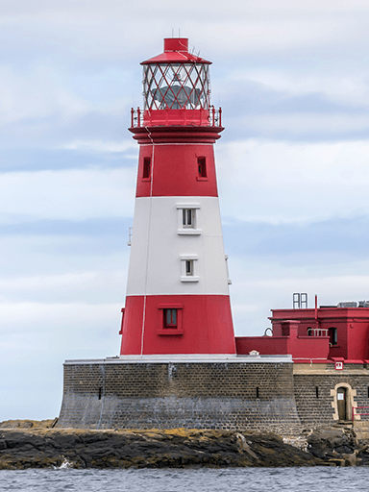
Coastlines
Unicorn Class
Summer Term 1
April 2024
TOPIC OVERVIEW
As Geographers we will learn about the locations of the five oceans in the world using maps and atlases, whilst exploring keys and compasses. We will explore human and physical features of a coastal town.
As Historians, we will learn about the famous sea explorer; Captain James Cook. We will also explore the coastal town of Whitby and how it has changed since 1760.
As Design Technologists, we will be exploring human features around the coast including; lighthouses, boats and ships then using construction kits to build these.
As Scientists we will explore the words floating and sinking before carrying out an experiment to explore items which float and sink, then group them accordingly.
ENGLISH
Descriptions: we will use adjectives to write a descriptive piece about a coastal town.
Narrative: After exploring a story, we will create our own based on the original.
Non-Chronological Report: Following our learning about a coastal town we will create our own non-chronological report based on the coastal town.
How you can help at home:
Ensure homework is completed
Read regularly at home together
Support your child to learn their spellings
Encourage writing experiences where possible
MATHEMATICS
Children will be taught key aspects of the following:
Year 1:
Multiplication & Division
Fractions
Position and Direction
Year 2:
Multiplication & Division
Fractions
How you can help at home:
Ensure your child completes their CGP books every week
Support your child to learn their number bonds to 10/100
Practice counting in 2s, 5s and 10s
Explore the app One Minute Maths to develop your child’s quick recall
RE
PSHE
What makes some people so important?
We will discuss the word important, explore people within different faiths and their religious stories. Then discuss why people are important to their faith.
Me and Others
We will begin by thinking about ourselves and our similarities and differences in relation to others. We will learn how we can be responsible and co-operative.
E-SAFETY & COMPUTING
MUSIC
In Computing we will be using a computer to create music. We will listen to a variety of pieces of music and consider how they make us feel. Then we will compare creating music digitally and non-digitally.
Vocal and Body Sounds
We will use our voices and body to create different sounds and then adapt them. We will create our own graphic score and play from it using instruments and our voices.
SMSC
ART
PE
FRENCH
We will use the coastline theme to develop our skills in painting, collage and drawing. We will use artists such as Save Chihuly, Takashi Murakami and Yayoi Kusama for our inspiration.
Striking and Fielding
We will be exploring ball related skills including; rolling, throwing, catching and striking.
Orienteering
We will explore compasses and where we are on a map.
We will be recalling what we have learnt previously about counting in French, as well as learning words to describe different feelings.
As part of our SMSC curriculum, we will participate in a variety of activities including RE Days, Pupil Voice, May Day and World Ocean Day.

