Slide 1
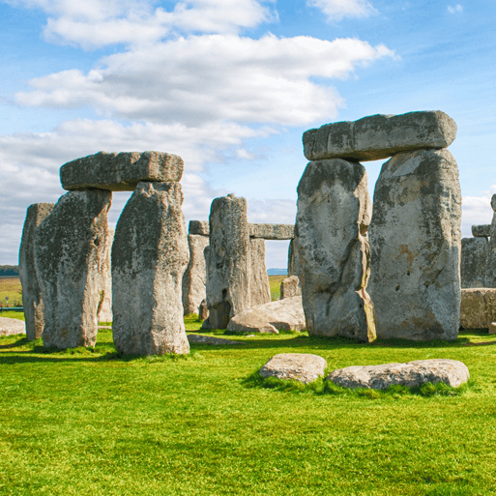
Through the Ages
Years 3 & 4
Summer Term 1
April 2024
TOPIC OVERVIEW
As Historians, we will be looking at all aspects of life during the Stone Age, Bronze Age and the Iron Age. This will include changes to people and lifestyle caused by ingenuity, invention and technological advancement.
As Scientists, we will be investigating shadows and how they change shape and size when the light source moves. We will also look at skeletons and how we and other animals move.
As Geographers, we will be looking at the British Isles and their Stone Age monuments and the placement of these. We will also be looking at the placement of villages in the Stone, Bronze and Iron Ages. We will also be reading grid references on a map.
As Design Technologists, we will be cooking basic food items, and creating prehistoric pots. We will also create our own version of Stonehenge!
ENGLISH
Poetry: Cinquains – poems of 5 lines with a pattern of 2, 4, 6, 8, 2 syllables per line
Narratives: We will be writing historical narratives where we write about an historical event, blending facts with imagined characters and situations..
Instructions: We will be writing instructions on how to make a bronze axe head.
Chronological reports: We will be writing a report on our work to show the developments from Stone Age through Bronze Age and ending in the Iron Age.
Class text: We will be reading Stig of the Dump by Clive King.
How you can help at home:
Ensure homework is completed
Discuss newly learnt words (spellings)
Encourage your child to read
MATHEMATICS
Children will be taught key aspects of the following:
Multiplication
Division
Length, area and perimeter
Fractions/decimals
Statistics
Money
How you can help at home:
Encourage your children to complete Times Tables Rock Stars every week
Ensure homework is completed
RE
PSHE
Why are sacred texts and holy
books so important?
We will explore the similarities and differences of the holy books of Christianity and Islam
Identity, society and
Equality
We will be ‘Celebrating difference’ with activities that show which groups we belong to including our communities.
E-SAFETY & COMPUTING
MUSIC
E-safety: We will be exploring the advantages and disadvantages of using texts and images.
Desktop publishing: We will be looking at text, font images, etc. and why these can be used to communicate messages.
Music:
We will be Sharing Musical Experiences. We will celebrate a wide range of musical styles through listening, singing, playing composing and performing
PE
Travel descriptions:
We will be learning the French terms for types of travel and creating a survey on the different types of travel used by the children.
ART
Games-Striking and fielding
& swimming:
In games we will be learning skills in cricket and rounders.
We will be swimming at Brize Norton, improving our swimming skills.
FRENCH
SMSC
Artists and techniques:
We will be making observational drawings, cave paintings, Stone Age jewellery and looking at the illustrations in the books Stone Age Boy by Satoshi Kitamura and Stig of the Dump by Clive King.
Events in school to support our
SMSC development will include; RE day, Pupil Voice, etc.

