Slide 1
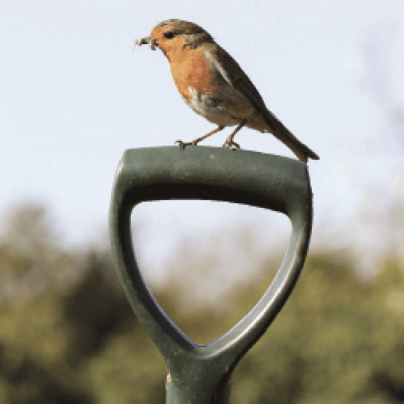
Griffin Topics
Summer Term 1
April 2024
TOPICS OVERVIEW
As Scientists, we will learn about electrical circuits, their components and how they function. We will design and make a programmable device. We will also look at how light behaves and explore how we see light and colours, and phenomena associated with light, including shadows, reflections and refraction.
As Geographers, we will learn about our changing world and revise the features of Earth. We will develop our map skills and find out more about map scales and symbols, grid references and contour lines. We will analyse data and carry out fieldwork. We will learn about climate change and the importance of global trade.
As Design Technologists, we will learn about remarkable engineers and significant bridges. We will discover how to identify features such as beams, arches and trusses. Finally, we will complete a bridge-building challenge to create a bridge prototype.
ENGLISH
Non-chronological reports: we will write reports about the produce grown on allotments
Instructions: we will write instructions on tree planting
Explanations: we will write explanations about different aspects of farming
Narrative: we will write stories about secret gardens
Poetry: we will write and perform poetry about allotments
Class text: The Secret Garden by Frances Hodgson Burnett
SPAG – apostrophes, sentence types, determiners, prepositions, adverbs, tenses.
How you can help at home:
Ensure homework is completed
Discuss newly learnt words (spellings)
Encourage your child to read
MATHEMATICS
Children will be taught key aspects of the following:
Statistics
Four operations
Shape
Co-ordinates
Revision
How you can help at home:
l
Ensure homework is completed
RE
PSHE
Beliefs
We will explore the question ‘how do our beliefs influence the way we treat the world?’ by looking at two religions – Christianity and Islam.
Borrowing & Earning Money.
We will talk about borrowing money and the risks associated with it. We will discuss enterprise and look at real-life examples. We will investigate what influences people's career choices.
E-SAFETY & COMPUTING
MUSIC
In E-safety we will explore the importance of on-line safety including privacy and security.
In Computing, we will be using a computer programme to produce 3D models.
Composition
In this unit we will explore the associations between music, sound and colour. We will compose a piece of music to represent Holi – the Hindu festival of colour which celebrates the triumph of good over evil.
SMSC
ART & DESIGN
PE
FRENCH
We will learn more about observational drawing, mixed media collage and Pop Art. We will consolidate our learning to make a final piece of artwork inspired by bees, beetles or butterflies.
We will develop our ball skills through playing tennis and rounders. We will also take part in gymnastics activities.
We will learn to speak with increasing confidence, fluency and spontaneity. Topics for this term include: le marché, au restaurant et a la plage.
We will explore spiritual, moral, cultural and social issues. We will do this through a range of events and activities including RE Day and Pupil Voice,

