Slide 1
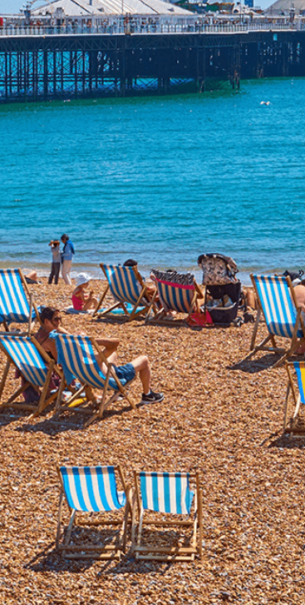
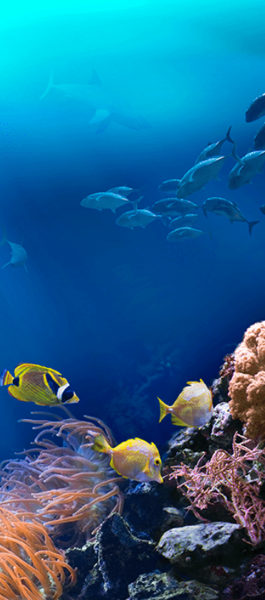
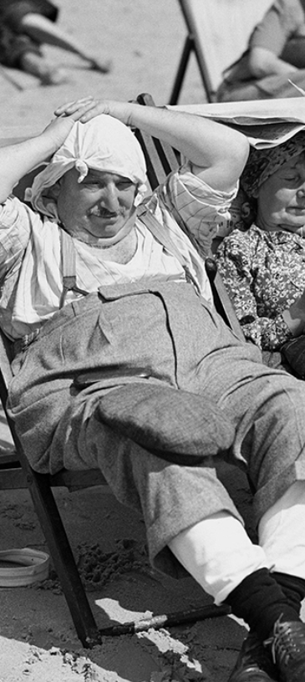
On The Beach
Pegasus Class
Summer Term June 2023
Characteristics of Learning
As investigative learners we will explore and experience things, and ‘have a go.’
As active learners we will concentrate and keep on trying if we encounter difficulties and enjoy our achievements.
As creative and critical thinkers we will generate and develop our own ideas, make links between ideas, and develop our own strategies for doing things.
.
LITERACY
MATHEMATICS
Personal, social and emotional development
Communication and Language
Reading-
Nursery will continue to develop their phonics knowledge through the topics; ‘Places to Visit’ and ‘Fantasy.’ Reception will continue to revisit their recognition of sounds using Level 3 diagraphs and then further manipulate these sounds within Level 4 Twinkl Phonics Programme. They will also continue to learn to read and spell a variety of tricky words.
We will listen to a range of stories with a theme of On The Beach, sing songs and share rhymes.
Writing- there will be opportunities for mark making inside and out. We will use our phonics knowledge to sound out words for postcards, letters and reports.
We will continue to practise correct letter formation when we write.
At home you could….
-share stories together
-make marks using pencils, paint, chalk or water
-encourage writing experiences
-share both fiction and non-fiction about the beach.
This term we will continue to use White Rose Mastery Guidance to explore the topic: ‘To 20 and Beyond’ and then move onto the topic: ‘First, Then, Now.’
We will be:
Number
-counting to 10 and beyond
-exploring counting patterns
-adding
-taking away/subtracting
Shape, Space and Measure
-exploring 3D shapes
-match and rotate shapes
-composing and decomposing shapes
At home you could….
-count objects above 10 around the house
-practise writing numbers 0-10
-explore different 3D shapes both inside and outside the house
-make repeating patterns with items in your house.
This term we will:-
Talk about what we need for a trip to the beach
Discuss the importance of staying safe in the sun
Discuss how to help keep our seas free from rubbish.
This term we will:-
-listen to others
-ask questions
-hold a conversation with others
-play games and sing songs related to sailing on the sea.
Understanding of the World
Physical Development
This term we will:-
-learn about animals which live on the beach
-learn about animals which live in the sea
-discuss caring for the environment
-explore sea life animals who are: herbivores, carnivores and omnivores.
This term we will:-
Gross Motor- access outside play on bikes, tricycles climbing frames and obstacle courses.
Fine Motor- use a range of small tools and funky finger activities to develop fine motor control.
Expressive Arts and Design
RE
We will develop our art skills by using a variety of materials to create sea life.
We will use our imagination in our role play area linked to our interests.
We will think about the question; ‘What makes places special?’
We will discuss places and homes around the world and then explore places of worships.
Events in school to support our SMSC development will include; weekly forest school, RE day and World Ocean Day.
SMSC

