Slide 1
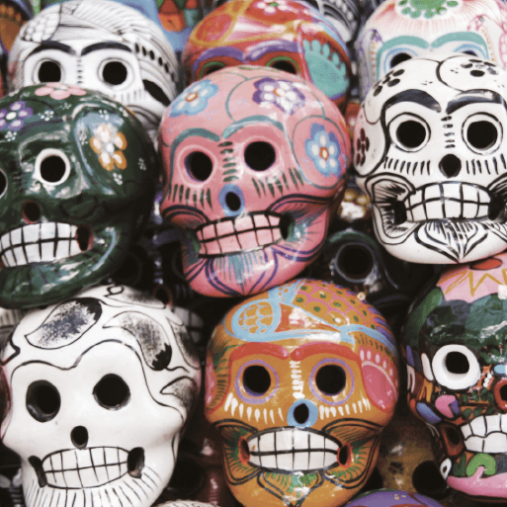
Hola Mexico!
Years 5 & 6
Autumn Term
2022
TOPIC OVERVIEW
As Artists, we will look closely at a range of Maya art and create our own pieces including sculpture, weaving, sketches and paintings.
As Design Technologists, we will make simple instruments out of junk materials and see who can make the loudest, highest and longest sounds.
As Scientists, we will investigate El Castillo, a pyramid shaped temple, and find out about the illusions created by shadows that surround it at different times of the day. We will conduct investigations to explore and record patterns in the size and shape of an object’s shadow. We will find out about and extract the natural dye cochineal to make red.
As Geographers, we will use maps and satellite images to locate Mexico and draw sketch maps showing aspects of its human and physical geography. We will find out about daily life in Mexico and compare it with life in the UK. We will locate some of the main cities of the ancient Maya civilisation and describe their geographical features.
As Historians, we will research aspects of ancient Maya civilization.
ENGLISH
Postcards: we will imagine we are in a desert and write postcards home describing our experience
Instructions: we will draft instructions for how to play a Mexican ball game
Myths and legends: we explore ancient Maya legends and use these as a basis for story writing
Poetry: we will write poems inspired by the varied landscapes of Mexico
Class text: Holes by Louis Sachar
SPAG – verbs, tenses, sentence types, adjectives, pronouns
How you can help at home:
Ensure homework is completed
Discuss newly learnt words (spellings)
Encourage your child to read
MATHEMATICS
We will be taught key aspects of the following:
Place Value
Addition
Subtraction
Multiplication
Division
How you can help at home:
Ensure your child completes Times Tables Rock Stars every week
Ensure homework is completed
RE
PSHE
Do clothes express beliefs?
We will explore whether people should be judged by what they wear and consider different attitudes towards religious clothing and values.
Physical health and well-being – In the Media
We will learn about how the media can manipulate images and that these images may not reflect reality.
E-SAFETY & COMPUTING
MUSIC
In E-safety we will explore on-line safety including privacy and security.
In Computing we will explore the concept of variables in programming through games in Scratch.
All things Mexico!
We will consider why music is so important to the Mexican people and listen to a range of traditional Mexican music. We will learn and perform a traditional Mexican song.
SMSC
ART & DESIGN
PE
FRENCH
Cultural development
We will explore how learning styles can influence learning. We will take part in activities to determine our own preferred learning styles and the impact that these preferences can have.
A taste of Mexico!
We will investigate recipes and create Mexican dishes and fruit drinks. We will taste foods enjoyed and introduced by the ancient Maya civilisation.
PE
We will develop our football skills including defending and attacking tactics. We will take part in gymnastics activities combining action, balance and shape to create sequences.
Our surroundings
Children will be taught to speak with increasing confidence, fluency and spontaneity. Topics for this term include: moi, ma famille, ma maison, mes loisirs.

