Slide 1
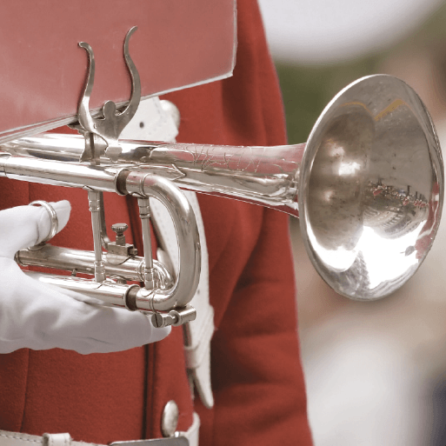
Land Ahoy!
Years 1 & 2
Summer Term 2
June 2022
TOPIC OVERVIEW
As Musicians we will be exploring many key aspects of music, including pulse and rhythm, how different instruments sound, how we can use our bodies and things around us to make music and of course the importance of singing and how it makes us feel.
As Geographers, we will be collecting outdoor items that make interesting sounds and exploring places where we can make different sounds; we will then be making a map to show our route and where these places can be found.
As Design Technologists, we will be using everyday resources to make a variety of different musical instruments.
As Scientists we will be using our senses to explore music and make sound maps. We will focus on our sense of hearing and complete some investigations around how distance affects what we hear and whether the size of our ears make a difference!
ENGLISH
Instructions: we will be looking at sequencing instructions and then writing our own.
Narratives: we will be writing alternative endings to fairy tales.
Poetry: we will explore the similarities and differences between lyrics and poetry and have a go at writing our own.
How you can help at home:
Ensure homework is completed
Read regularly at home together
Support your child to learn their spellings
Encourage writing experiences where possible
MATHEMATICS
Children will be taught key aspects of the following:
Position and Direction
Mass
Capacity
Temperature
How you can help at home:
Ensure your child completes Numbots and/or Times Tables Rock Stars every week
Ensure homework is completed
Support your child to learn their number bonds to 10/100
Practise counting in 2s, 5s and 10s and beyond if appropriate
Y2s – Learn times tables facts
RE
PSHE
How should you spend the weekend?
We will be thinking about how we spend the weekend and what we do with our leisure time. We will then learn about how Jewish families spend their weekends and the rules that they follow.
My Money
We will think about where money comes from and the choices we make when spending money. We will consider ways to keep money safe and how to save it.
E-SAFETY & COMPUTING
MUSIC
In Computing we will be using a computer to create music. We will listen to a variety of pieces of music and consider how they make us feel. Then we will compare creating music digitally and non-digitally.
Your Imagination
We will be exploring a variety of songs from well known films that are all linked to the theme of imagination! We will listen to and appraise these pieces of music as well as continue to play our instruments.
SMSC
ART
Being curious about differences
We will think about our similarities and differences and consider what shapes us as individuals. We will identify the things that individuals and groups have in common.
Themes
We will use the theme of music to explore art this term. We will be making observational drawings of musical instruments as well as using instruments as inspiration for our art.
Athletics and Dance
In athletics we will thinking about how we can use our bodies with control, to help with the skills of running, jumping and throwing. We will also be making up short sequences of movements to make our own dances.
PE
Pronunciation and Instructions
We will be thinking carefully about our French pronunciations and how some sounds are said differently. We will learn words to help us follow simple instructions.
FRENCH

