Slide 1
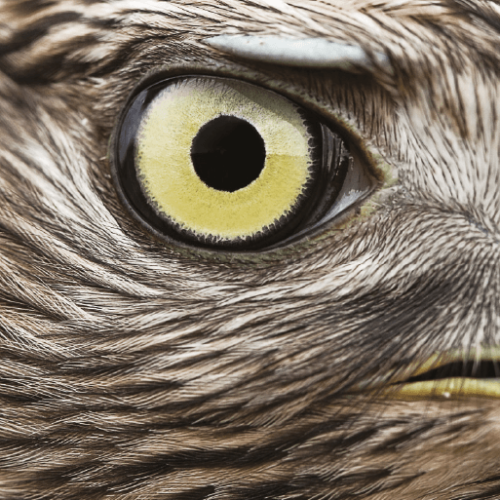
Predator!
Years 3 & 4
Summer Term
June 2022
TOPIC OVERVIEW
As Historians, we will be look at Predators from the past and compare them to present day predators.
As Scientists, we will be looking at carnivorous and parasitic plants, some of the deadly aquatic predators in the world and the difference between parasites and predators.
As Geographers, we will locate the distribution of species. Where would you find alligators and crocodiles? Or caimans and the Indian gharial? Where does a Peregrine falcon live?
As Design Technologists, we will create our own predator!
ENGLISH
Leaflets: We will create a leaflet on one of the world’s top predators.
Poetry: We will be learning about Haiku poems.
Dilemma stories: We will create our own dilemma stories that include a predator, real or fictional.
Speeches: We will give a speech to our classmates about our favourite predator and why it is our favourite.
Class text: The Enormous Crocodile by Roald Dahl
How you can help at home:
Ensure homework is completed
Discuss newly learnt words (spellings)
Encourage your child to read
MATHEMATICS
Children will be taught key aspects of the following:
Fractions
Time
Mass and capacity
Properties of shape
Decimals
Position and direction
How you can help at home:
Ensure your children completes Times Tables Rock Stars every week
Ensure homework is completed
Does prayer change things?
We will be looking at different types of prayer. Why do people pray and what do they hope to achieve from it? Ultimately, we will write our own prayer.
RE
PSHE
Physical health and well-being:
We will learn about what can help us choose. We will look at the importance of recognising and managing influence and pressure when making our choices.
E-SAFETY & COMPUTING
E-safety:
Internet Safety and Copy Write .
Computing: Sequencing events and actions
Through the Scratch app, we will be continuing to program a sprite to move and do actions, ultimately to navigate through a maze.
Music:
Three Little Birds
We will look at the elements of music (pulse, rhythm, pitch etc.), singing and playing instruments. During these lessons, children will listen and appraise other Reggae songs.
MUSIC
Artists and techniques:
We will create paper collages of
bald eagles and use chalk to create pictures of wolves
We will sketch and then use watercolour paints to create observational art of crocodile heads
We will create lion artwork based on the work of Leroy Neiman
We will make sketches of birds in flight
ART
PE
Families:
We will be learning the
nouns for family members and then describing them using our knowledge of colours, body parts and numbers.
Life’s fundamental questions:
We will be asking questions
such as Why am I me? Why am I here?
How can I develop a mind of my own?
What do I like/dislike? What defines right and wrong?
FRENCH
SMSC
Athletics and net games:
In games we will learning skills in tennis.
In athletics, we will improving our running, both sprint and long distance, jumping and throwing skills.

