Slide 1
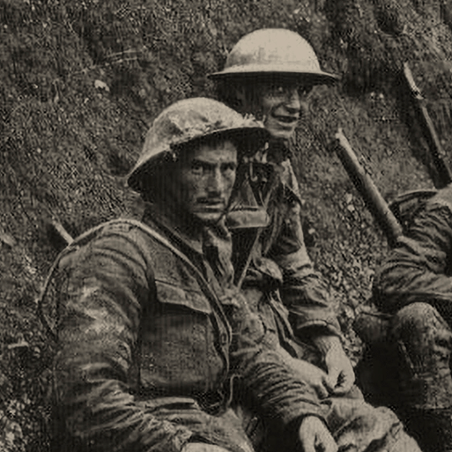





Britain at War
Years 5 & 6
Autumn Term 2
2025
TOPIC OVERVIEW
As Historians, we will learn about World War I & 2; causes, warfare, weaponry & life at home.
As Scientists, we will learn about light, the human eye and refraction.
As Geographers, we will investigate the Axis and Allied Powers and draw comparisons between alliances in the First and Second World Wars.
As Design Technologists, we will learn more about the ‘Make do and Mend’ campaign. We will use a range of simple sewing stiches to recycle and repurpose old clothes and materials.
ENGLISH
Speeches: we will identify and understand the features of a great speech before planning and delivering a speech
Drama – we will take part in a role play based on WW2
Story writing: we will write a historical narrative
Recount – we will write a recount of our class trip
Class text: Goodnight Mister Tom by Michelle Magorian
SPAG – punctuation, clauses, word classes, verb tenses
How you can help at home:
Ensure homework is completed
Discuss newly learnt words (spellings)
Encourage daily reading
MATHEMATICS
Children will be taught key aspects of the following:
Fractions
Decimals
Percentages
Geometry
How you can help at home:
Ensure homework is completed
Practise mental maths skills using One Minute Maths – 1-minute maths app | White Rose Education
RE
PSHE
How do rites of passage shape the lives of different Christians?
We will consider the symbolism of Baptism and look at denominational differences including Baptist, Anglican and Orthodox.
Keeping safe and managing risk
We will investigate a variety of scenarios and learn about how we can act safely and manage risks successfully.
E-SAFETY & COMPUTING
MUSIC
In E-safety we will explore the importance of on-line safety including privacy and security.
In Computing we will learn how to use the different drawing tools and how images are created in layers.
Music appreciation
During this unit we will build on previous learning, find out about different musicians and explore musical styles.
During this term we will participate in activities that support our spiritual, moral, social and cultural education including Remembrance, Interfaith week and Christmas activities.
SMSC
ART & DESIGN
Our surroundings
Children will be taught to speak with increasing confidence, fluency and spontaneity. Topics for this term include: fruit, vegetables, au restaurant and le noel.
PE
We will participate in multi-skills activities. We will develop our skills and abilities in parkour.
PE
FRENCH
Bees, Beetles and Butterflies
This project teaches children about sketchbooks, observational drawing and mixed media collage.

