Slide 1
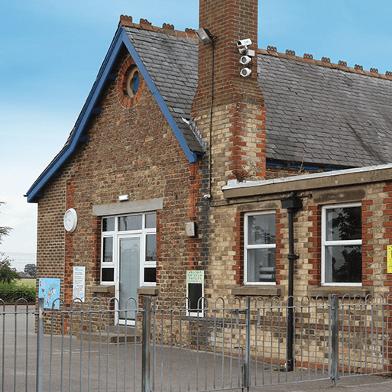
School Days
Years 1 & 2
Summer Term
June 2025
TOPIC OVERVIEW
As Historians, we will be learning about school life in the past. We will be focusing on the Victorian era and what school would have been like for children. We will explore artefacts and sources from the era and think about how they are the same or different to what we use/do now. We will also learn about historically significant people from the era.
As Geographers, we explore the locality of the school and the community and how it has changed over time.
As Design Technologists, we will build models of a classroom from the Victorian era and now and use them to compare how things have changed.
As Scientists, we will learn about wild and garden plants by exploring the local environment. We will identify parts of plants and how they change over time.
ENGLISH
Non- Chronological Reports: We will write non-chronological reports on both our school and schools from the Victorian Era.
Stories with a familiar setting: We will use our own experience to write a story based in a school.
Diaries: We will write a diary entry to describe how it felt during a Victorian school lesson, thinking about the phrases and sequencing words we need.
We will continue to read our class text: George’s Marvellous Medicine.
How you can help at home:
Ensure homework is completed
Read regularly at home together
Support your child to learn their spellings
Encourage writing experiences where possible
MATHEMATICS
Children will be taught key aspects of the following:
Year 1:
Fractions
Position and Direction
Place Value within 100
Year 2:
Mass, capacity and temperature
Fractions
Time
How you can help at home:
Ensure homework is completed
Support your child to learn their number bonds to 20/100
Explore the One Minute Maths App
RE
PSHE
Careers, financial capability and
economic wellbeing
We will be learning about where money comes from and making choices when to spend money. We will also discuss how to keep money safe.
What are the best reasons for following a leader?
We will explore qualities which show someone as a leader and how these qualities should be evaluated.
E-SAFETY & COMPUTING
MUSIC
In Computing we will continue to think about digital music. We will learn to use a computer as a tool to explore rhythms and melodies, before creating a musical composition.
Musical Me: Pitch
We will learn about pitch, singing high and low notes, playing patterns of high and low notes on instruments and draw high and low sounds using dots.
We are going to compare and contrast Victorian and modern day houses and sketch Victorian houses. We are going to look at the artist William Morris and do some block printing and try to design some wallpaper.
ART
Tennis and Forest School.
We will be developing or racket grip and using a racket to control a ball. In Forest School, we will continue to explore and create in the natural world.
PE
SMSC
As part of our SMSC curriculum, children will participate in a variety of activities including RE Day, forest school, and Pupil Voice.

