Slide 1
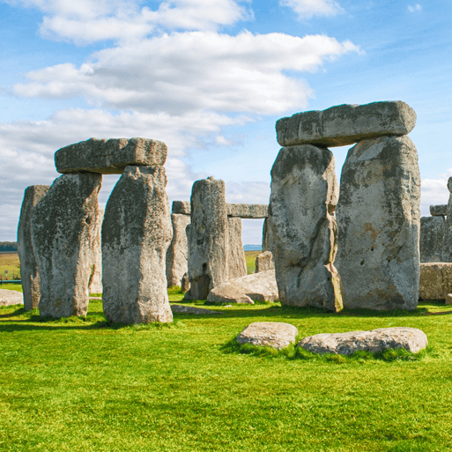
Through the Ages
Years 3 & 4
Autumn Term 1
September ‘25
TOPIC OVERVIEW
As Historians, we will be looking at all aspects of life during the Stone Age, Bronze Age and the Iron Age. This will include changes to people and lifestyle caused by ingenuity, invention and technological advancement.
As Scientists, we will be investigating shadows and how they change shape and size when the light source moves. We will also look at skeletons and how we and other animals move.
As Geographers, we will be looking at the British Isles and their Stone Age monuments and the placement of these. We will also be looking at the placement of villages in the Stone, Bronze and Iron Ages. We will also be reading grid references on a map.
As Design Technologists, we will be cooking basic food items, and creating prehistoric pots. We will also create our own version of Stonehenge!
ENGLISH
Poetry: Cinquains – poems of 5 lines with a pattern of 2, 4, 6, 8, 2 syllables per line
Narratives: We will be writing historical narratives where we write about an historical event, blending facts with imagined characters and situations.
Instructions: We will be writing instructions on how to make a bronze axe head.
Chronological reports: We will be writing a report on our work to show the developments from Stone Age through Bronze Age and ending in the Iron Age.
Class text: We will be reading Stig of the Dump by Clive King.
How you can help at home:
Ensure homework is completed
Discuss newly learnt words (spellings)
Encourage your child to read
MATHEMATICS
Children will be taught key aspects of the following:
Place Value
Addition
Subtraction
Multiplication
Division
How you can help at home:
Ensure your children practise their times tables every week
Ensure homework is completed
RE
PSHE
Physical health and well-being:
What is important to me? Pupils learn why people may eat or avoid certain foods (religious, moral, cultural or health reasons).
How are different people inspired by the teachings of Jesus? We will look at the concept of Gospel and explore how Jesus treated people – discipleship, followers, love, etc.
E-SAFETY & COMPUTING
MUSIC
Computing:
We will be looking at how computers are connected, focusing on inputs, processes, and outputs, digital and non-digital devices, wireless access points and switches.
Music:
We will be studying Ballads. We will learn what ballads are, how to identify their features and how to convey different emotions when performing them.
PE
Our surroundings:
We will be learning to speak with increasing confidence, fluency and spontaneity. Topics for this term include greetings and early general conversation.
ART
Invasion games & gymnastics:
We will play football understanding the rules and learning some skills for the pitch. In gymnastics, we will be composing a sequence of movements with partners involving shape and apparatus.
FRENCH
SMSC
Artists and techniques:
We will be making observational drawings, cave paintings, Stone Age jewellery and looking at the illustrations in the book Stone Age Boy by Satoshi Kitamura and Stig of the Dump by Clive King.
Events in school to support our
SMSC development will include; RE day, Pupil Voice and Black History Month.

