Slide 1
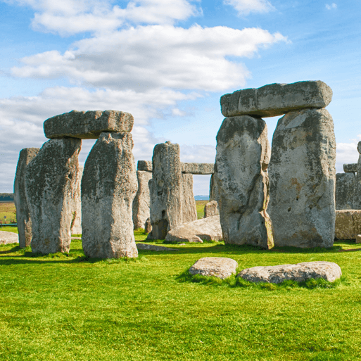





Through the Ages
Years 3 & 4
Autumn Term 2
November 2025
TOPIC OVERVIEW
As Historians, we will be looking at all aspects of life during the Stone Age, Bronze Age and the Iron Age. This will include changes to people and lifestyle caused by ingenuity, invention and technological advancement.
As Scientists, we will be investigating shadows and how they change shape and size when the light source moves. We will also look at skeletons and how we and other animals move.
As Geographers, we will be looking at the British Isles and their Stone Age monuments and the placement of these. We will also be looking at the placement of villages in the Stone, Bronze and Iron Ages. We will also be reading grid references on a map.
As Design Technologists, we will be cooking basic food items, and creating prehistoric pots. We will also create our own version of Stonehenge!
ENGLISH
MATHEMATICS
Poetry: Cinquains – poems of 5 lines with a pattern of 2, 4, 6, 8, 2 syllables per line
Stories: We will be writing stories based on life in the Bronze Age
Chronological reports: We will be writing a report on our work to show the developments from Stone Age through Bronze Age and ending in the Iron Age
Class text: We will continue reading Stig of the Dump by Clive King and Stone Age Boy by Satoshi Kitamura
How you can help at home:
Ensure homework is completed
Discuss newly learnt words (spellings)
Encourage your child to read
Children will be taught key aspects of the following:
Addition
Subtraction
Multiplication
Division
Length, area and perimeter
How you can help at home:
Encourage your children to complete Times Tables Rock Stars every week
Ensure homework is completed
RE
PSHE
How does the worldwide Christian
family celebrate, worship and mark key events?
We will explore some of the main festivals of Christianity and how they are celebrated around the world.
Keeping safe:
We will be looking at keeping safe at school and bullying using the slogan – see it, say it, stop it .
E-SAFETY & COMPUTING
MUSIC
E-safety: We will be exploring the advantages and disadvantages of using texts and images.
Desktop publishing: We will be looking at text, font images, etc. and why these can be used to communicate messages.
Rock and Roll:
We will be learning about the origin and features of rock and roll music. Pupils will
learn how to play the Hand Jive and
Rock Around the Clock, looking
specifically at a walking bass line, before performing a piece as a class.
.
SMSC
Events in school to support our
SMSC development will include; RE day, Pupil Voice, Anti Bullying Week, Christmas etc.
FRENCH
ART
PE
Adjectives:
We will describe some of the shapes in their work using language of colour, size or shape. We will also listen and then select the correct decoration according to its colour.
Artists and techniques:
We will be looking at colour theory, Bronze Age jewellery and looking at the illustrations in the books Stone Age Boy by Satoshi Kitamura and Stig of the Dump by Clive King.
Dance & Forest School:
We will be learning some dance moves that will be co-ordinated to winter/Christmas themes.
Forest School will enable us to learn through the outdoors.

