Slide 1
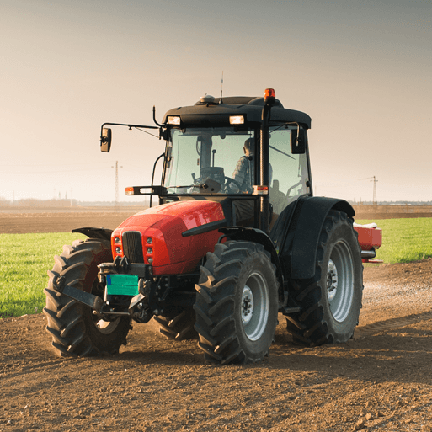





Sow, Grow and Farm
Years 5 & 6
Summer Term 1
April 2025
TOPIC OVERVIEW
As Scientists, we will find out what different types of compost are made from by exploring their textures and smells. We will investigate which materials are biodegradable and compare and display digital photographs of the items before and after being buried. We will conduct an investigation to explore the germination of seeds in different conditions and find out which fruits and vegetables can be planted in the current season. We will observe and monitor new plant growth throughout the project learning how to care for seeds, bulbs and saplings. We will also research the life cycle of key pollinators such as bees, butterflies and bats.
As Geographers, we will identify the location of allotments in the area. We will annotate world maps to show the origins of some fruit and vegetables. We will investigate farming in the UK and compare and contrast this with farming practices in North or South America.
As Design Technologists, we will make tasty dishes using some of the UK’s commonest crops. We will build a simple propagator and plant seeds and cuttings.
ENGLISH
Non-chronological reports: we will write reports about an aspect of allotments
Diaries: we will write a diary entry from the point of view of a UK farmer
Leaflets: we will write a leaflet to persuade families to buy fair trade produce
Balanced arguments: we will create a proposal for a market garden
Class text: The Secret Garden by Frances Hodgson Burnett
SPAG – apostrophes, sentence types, determiners, prepositions, adverbs, tenses, revision
How you can help at home:
Ensure homework is completed
Discuss newly learnt words (spellings)
Encourage your child to read
MATHEMATICS
Children will be taught key aspects of the following:
Statistics
Four operations
Shape
Co-ordinates
Revision
How you can help at home:
Ensure homework is completed
Practise mental maths skills using One Minute Maths – 1-minute maths app | White Rose Education
RE
PSHE
What might a Hindu gain from a
pilgrimage to India?
We will explore the places that Hindus might visit in India and hear from people who have done a pilgrimage. We will consider the spiritual impact and the sense of community that a pilgrimage might give a believer.
Identity, society and equality
Human rights
We will discuss the experience of refugees in the UK and the difficulties that they may face. We explore what a home means to us all.
E-SAFETY & COMPUTING
MUSIC
Composition
In this unit we will explore the associations between music, sound and colour. We will compose a piece of music to represent Holi – the Hindu festival of colour which celebrates the triumph of good over evil.
In E-safety we will explore the importance of on-line safety including privacy and security.
In Computing, we will be exploring how data is transferred by working collaboratively online.
SMSC
ART & DESIGN
PE
FRENCH
Line, Light and Shadows
We will learn about the visual qualities of line, light and shadows and explore a range of shading techniques. We will explore the work of Pablo Picasso and Rembrandt.
PE
We will develop our striking and fielding skills through playing cricket and rounders. We will also take part in outdoor adventurous activities such as map reading and navigation.
French
We will learn to speak with increasing confidence, fluency and spontaneity. Topics for this term include: la boussole, le temps.
We will explore spiritual, moral, cultural and social issues. We will do this through a range of events and activities including RE Day and Pupil Voice.

