Slide 1
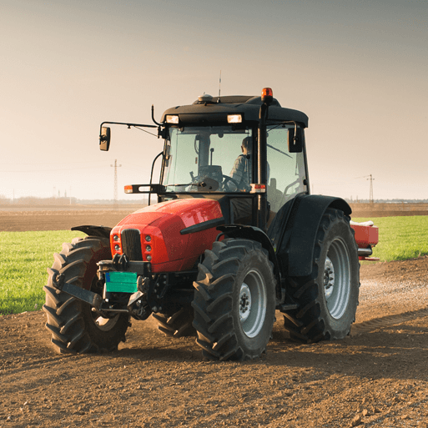
Sow, Grow and Farm
Years 5 & 6
Summer Term 2
June 2025
TOPIC OVERVIEW
As Scientists, we will find out what different types of compost are made from by exploring their textures and smells. We will investigate which materials are biodegradable and compare and display digital photographs of the items before and after being buried. We will conduct an investigation to explore the germination of seeds in different conditions and find out which fruits and vegetables can be planted in the current season. We will observe and monitor new plant growth throughout the project learning how to care for seeds, bulbs and saplings. We will also research the life cycle of key pollinators such as bees, butterflies and bats.
As Geographers, we will identify the location of allotments in the area. We will annotate world maps to show the origins of some fruit and vegetables. We will investigate farming in the UK and compare and contrast this with farming practices in North or South America.
As Design Technologists, we will make tasty dishes using some of the UK’s commonest crops. We will build a simple propagator and plant seeds and cuttings.
ENGLISH
Non-chronological reports: we will write reports about an aspect of allotments
Diaries: we will write a diary entry from the point of view of a UK farmer
Leaflets: we will write a leaflet to persuade families to buy fair trade produce
Balanced arguments: we will create a proposal for a market garden
SPAG – apostrophes, sentence types, determiners, prepositions, adverbs, tenses.
How you can help at home:
Ensure homework is completed
Discuss newly learnt words (spellings)
Encourage your child to read
MATHEMATICS
Children will be taught key aspects of the following:
Shape
Geometry
Measurement
Problem solving
How you can help at home:
Ensure homework is completed
Practise mental maths skills using One Minute Maths – 1-minute maths app | White Rose Education
RE
Sex, Relationships Education
We will learn about the changes during puberty, healthy relationships and human reproduction.
How does a world view help people
decide what is important?
We will explore how beliefs can influence the choices people make. We will find out more about reasoning and false reasoning. We will learn about Phillipa Foot and her thought experiment called the Trolly Problem.
PSHE
E-SAFETY & COMPUTING
MUSIC
In E-safety we will explore the importance of on-line safety including privacy and security.
In Computing, we will be exploring web page creation. We identify what makes a good web page and use this information to design and evaluate their own website using Google Sites.
School Production
We will develop our singing and musical skills whilst taking part in the end of year school production.
SMSC
ART & DESIGN
PE
FRENCH
Nature’s Art
We will learn about the genre of land art. We will work outdoors to sketch natural forms and explore the sculptural potential of natural materials. We will make land art installations.
PE
We will develop our ball skills through playing rounders. We will take part in athletics and swimming.
French
We will learn to speak with increasing confidence, fluency and spontaneity. Topics for this term include: le marché, au restaurant et a la plage.
We will explore spiritual, moral, cultural and social issues. We will do this through a range of events and activities including the Leavers’ Service, RE Day and Pupil Voice.

