Slide 1
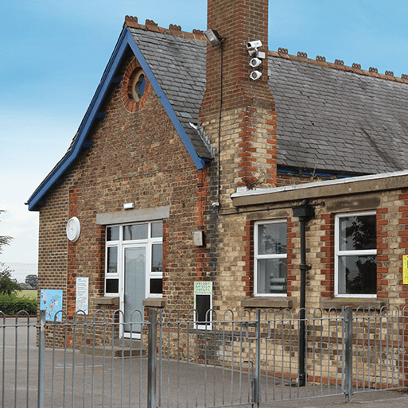
School Days
Years 1 & 2
Summer Term
April 2025
TOPIC OVERVIEW
As Historians, we’ll be learning about school life in the past. We will be focusing on the Victorian era and what school would have been like for children. We will explore artefacts and sources from the era and think about how they are the same or different to what we use/do now. We will also learn about historically significant people from the era.
As Geographers, we’ll explore the locality of the school and the community and how it has changed over time.
As Design Technologists, we’ll build models of a classroom from the Victorian era and now and use them to compare how things have changed.
As Scientists, we’ll learn about wild and garden plants by exploring the local environment. We will identify parts of plants and how they change over time.
ENGLISH
Poems: we’ll write our own poems to celebrate life in school, thinking about specific vocabulary we can use
Diaries: we’ll write a diary entry to describe how it felt during a Victorian school lesson, thinking about the phrases and sequencing words we need
Letters: we’ll reflect on the positive contributions we can make to school and write letters to Mrs Davies
We will continue to read our class text: George’s Marvellous Medicine.
How you can help at home:
Ensure homework is completed
Read regularly at home together
Support your child to learn their spellings
Encourage writing experiences where possible
MATHEMATICS
Children will be taught key aspects of the following:
Year 1:
Multiplication and Division
Fractions
Year 2:
Multiplication and Division
Length and Height
How you can help at home:
Ensure homework is completed
Support your child to learn their number bonds to 20/100
Explore the One Minute Maths App
RE
PSHE
In what ways is the synagogue important to Jews?
We will explore how the synagogue is the centre of the community for many Jewish people where they come together for learning, prayer, and service.
Me and Others
We will begin by thinking about ourselves and our similarities and differences in relation to others. We will learn how we can be responsible and co-operative.
E-SAFETY & COMPUTING
MUSIC
In Computing we will be thinking about digital music. We will learn to use a computer as a tool to explore rhythms and melodies, before creating a musical composition.
Musical Story Telling: Instruments
We will learn how events, actions and feelings within stories can be represented by pitch, dynamics and tempo.
Street View
We will learn about artwork depicting streets and buildings and focus on the work of the American pop artist, James Rizzi. We will create 2D and 3D artwork in his style, using local buildings as a template.
Striking and Fielding and Forest School.
We will be exploring ball related skills including; rolling, throwing, catching and striking. In forest school, we will be exploring and creating in the natural world.
PE
ART
As part of our SMSC curriculum, children will participate in a variety of activities including RE Day, VE Day, forest school, and St George’s Day.
SMSC

