Slide 1
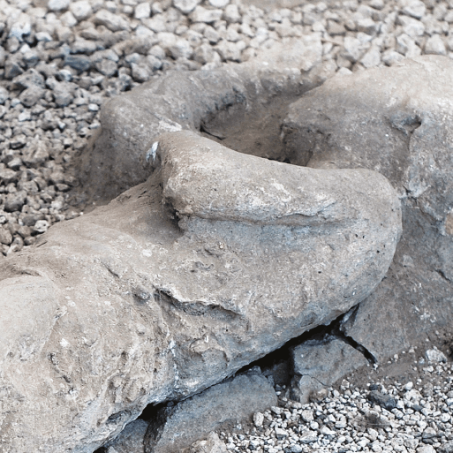





Rocks, Rumbles and Relics
Years 3 & 4
Spring Term
January 2026
TOPIC OVERVIEW
As Historians, we will investigate Pompeii and its destruction and look more deeply into the life and work of Mary Anning.
As Scientists, we will investigate different rocks and we will be asking the question “What is sand?”. We will investigate different soils and how fossils are created. We will also look at the topic of Forces and Magnets.
As Geographers, we will use maps to identify the major volcanoes of the world and the “Ring of Fire”. We will investigate the cause of volcanoes, earthquakes and tsunamis.
ENGLISH
Poetry: We will learn about language and rhythm.
Stories: We will be creating our own dilemma stories with an underwater theme.
Newspaper Articles: We will analyse newspaper reports of earthquakes or erosion related disasters noting the language, techniques and layout.
Narratives: We will be planning a short narrative from the point of view of a natural disaster.
Class text: The Firework Maker’s Daughter by Philip Pullman.
How you can help at home:
Ensure homework is completed.
Discuss newly learnt words (spellings).
Encourage your child to read.
MATHEMATICS
Children will be taught key aspects of the following:
Addition
Subtraction
Multiplication
Division
Measure (perimeter)
How you can help at home:
Ensure your child practises their Times Tables every week.
Ensure homework is completed.
RE
Mental Health and Well-Being:
We will be looking at Strengths and Challenges. We will help each other to highlight our strengths and hopefully adapt to learn new skills and master skills we already know.
Does art help with understanding
stories?
We will be looking at parables, especially those about the Kingdom of Heaven and forgiveness.
PSHE
E-SAFETY & COMPUTING
MUSIC
Repetition in shapes
We will use a text-based programming language (Scratch app) to explore count-controlled loops when drawing shapes.
Music:
We will be looking at Creating Compositions in response to an animation (Theme: Mountains).
PE
Playground Games:
We will be learning to count in French and recognize the words in writing. We will be able to answer questions about our age and be able to respond to number related questions.
ART
Invasion games & gymnastics:
We will play football, understanding the rules and learning some skills for the pitch. In gymnastics, we will be composing a sequence of movements with partners involving shape and apparatus.
FRENCH
SMSC
Artists and techniques:
We will study the figure drawings and urban landscapes of the artist LS Lowry and create artwork in his style to show scenes from our school.
Events in school to support our
SMSC development will include; RE day, Safer Internet Day, etc.

