Slide 1
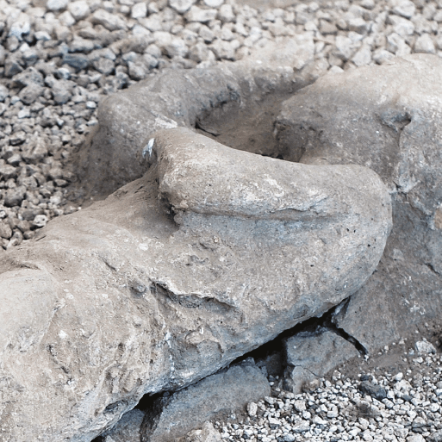





Rocks, Rumbles and Relics
Years 3 & 4
Spring Term
February 2026
TOPIC OVERVIEW
As Historians, we will investigate Pompeii and its destruction and look more deeply into recent earthquakes and tsunamis.
As Scientists, we will investigate different rocks and we will be asking the question “What is sand?”. We will investigate different soils and how fossils are created. We will continue to look at the topic of Forces and Magnets. This half term will be predominately on the force of magnetism.
As Geographers, we will use maps to identify the major volcanoes of the world and the “Ring of Fire”. We will investigate the cause of volcanoes, earthquakes and tsunamis.
ENGLISH
Stories: We will be creating our own dilemma stories with an underwater theme.
Newspaper Articles: We will analyse newspaper reports of earthquakes or erosion related disasters noting the language, techniques and layout.
Narratives: We will be planning a short narrative from the point of view of a natural disaster.
Class text: The Firework Maker’s Daughter by Philip Pullman and use extracts from various non-fiction books.
How you can help at home:
Ensure homework is completed.
Discuss newly learnt words (spellings).
Encourage your child to read.
MATHEMATICS
Children will be taught key aspects of the following:
Addition
Subtraction
Multiplication
Division
Measure (perimeter)
Fractions
How you can help at home:
Ensure your children practices their Times Tables every week.
Ensure homework is completed.
RE
PSHE
What do Muslims believe about God
and where did Islam start?
We will learn about Tawhid, Muhammad, the Night of Power, monotheism in a polytheistic culture and the 99 names of Allah.
Tobacco is a drug:
We will look at the effects of
smoking on the body and peer pressure as a reason that people start to smoke and how people use vaping as an alternative.
E-SAFETY & COMPUTING
Data logging:
We will learn about data loggers ,
recognising how and why data is collected over time, before using data loggers to carry out an investigation,
MUSIC
Music:
Through the topic of Samba and carnival sounds and instruments, we will learn to identify the key features of Samba music. The children will learn how to play syncopated rhythms with breaks.
SMSC
ART
PE
FRENCH
Events in school to support our
SMSC development will include; RE day, Pupil Voice, Lent, Easter.
Artists and techniques:
We will be looking at ammonites and artistic techniques used in sketching, printmaking and sculpture.
Netball & H.R.E:
We will use skills learned to play a game of High 5 Netball, focusing on positions and active sideline roles.
In Heart, Respiratory Exercise , we will improve heart and lung capacity through exercise.
The French Classroom:
We will learn the names of items found predominately in the classroom alongside simple classroom instructions.

