Slide 1
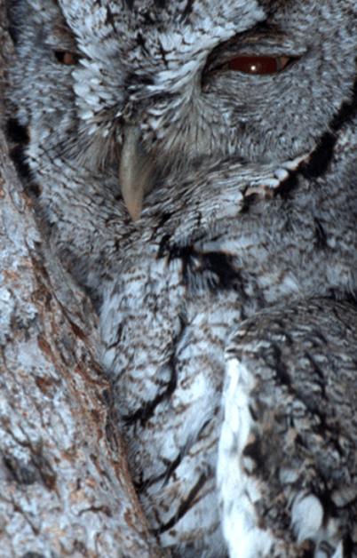
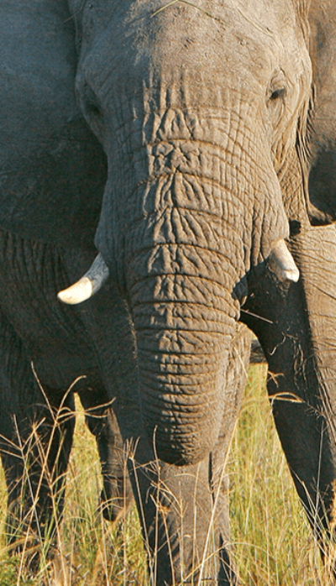
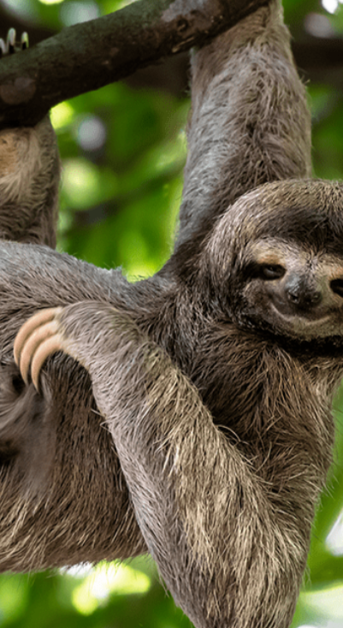
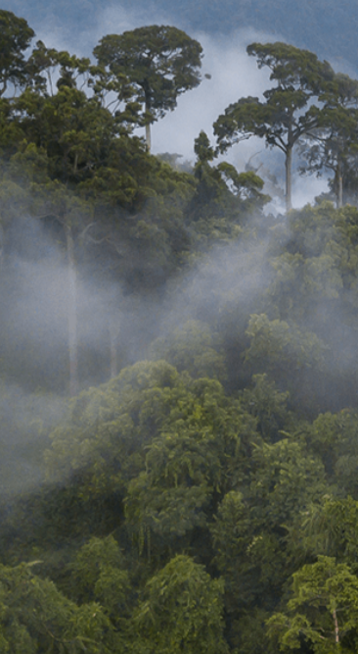
Animal Safari
Pegasus Class
Summer Term April 2025
Characteristics of Learning
As investigative learners we will explore and experience things, and ‘have a go.’
As active learners we will concentrate and keep on trying if we encounter difficulties and enjoy our achievements.
As creative and critical thinkers we will generate and develop our own ideas, make links between ideas, and develop our own strategies for doing things.
.
LITERACY
MATHEMATICS
Personal, social and emotional development
Communication and Language
Reading-
Nursery will continue to develop their phonics knowledge through the topics; ‘Animals’ and ‘Places to Visit’. Reception will continue to revisit their recognition of sounds using Level 3 diagraphs and then further manipulate these sounds within Level 4 of our Twinkl Phonics Programme. They will also continue to learn to read and spell a variety of tricky words.
We will listen to a range of stories with a theme of Animal Safari, sing songs and share rhymes.
Writing- there will be opportunities for mark making inside and out. We will use our phonics knowledge to sound out words for recounts, lists and poetry.
We will continue to practise correct letter formation when we write.
At home you could….
-share stories together
-make marks using pencils, paint, chalk or water
-encourage writing experiences
-share both fiction and non-fiction animal books
This term we will continue to use White Rose Mastery Guidance to explore the topic: ‘Building 9 & 10’ and then move onto ‘To 20 and Beyond.’
We will be:
Number
-counting to 10 and beyond
-exploring counting patterns
-comparing numbers to 10
-exploring number bonds to 10
Shape, Space and Measure
-exploring 3D shapes
-exploring repeating patterns
-composing and decomposing shapes
At home you could….
-count objects up to ten and above around the house
-practise writing numbers 0-10/20
-bake
-explore different 3D shapes both inside and outside the house
-make repeating patterns with items in your house
-use the 1 Minute Maths App to practise subitising and number bonds
This term we will:-
-talk about our pets and how we care for them
-discuss times when we were brave and tried something new
This term we will:-
-talk about what animals we like
-listen to others
-ask questions
-hold a conversation with others
Understanding of the World
Physical Development
This term we will:-
-learn about animals from around the world
-learn about herbivores and carnivores
-talk about similarities and differences between animals
-discuss caring for the environment
This term we will:-
Gross Motor- access outside play on bikes, tricycles climbing frames and obstacle courses.
Fine Motor- use a range of small tools and funky finger activities to develop fine motor control.
Expressive Arts and Design
RE
We will develop our art skills by sketching animals from around the world and use different materials to create bugs and other animals. We will look closely at Matisse’s The Snail and create some snail inspired artwork.
We will use our imagination in our role play area linked to our interests.
We will think about the question; ‘Are All Families the Same?’
We will explore the diversity found within, as well as between families. Our learning will introduce the idea of difference and respect for difference.
Events in school to support our SMSC development will include; weekly forest school, RE day, VE Day and May Day.
SMSC

