Slide 1
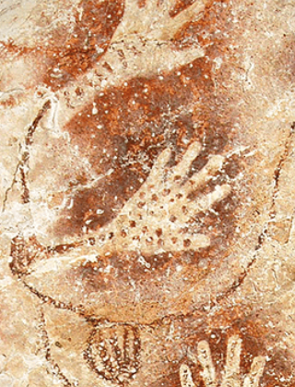
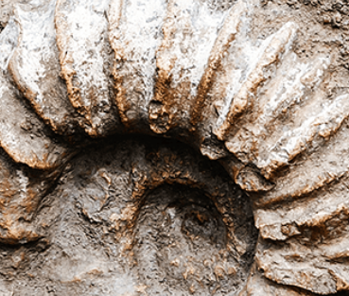
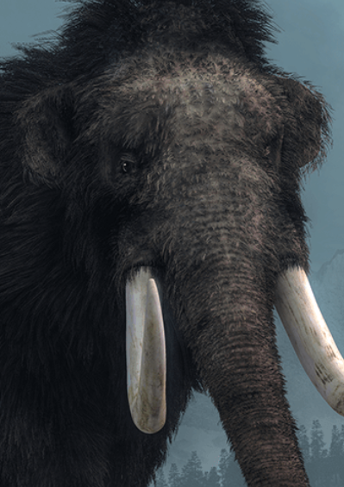
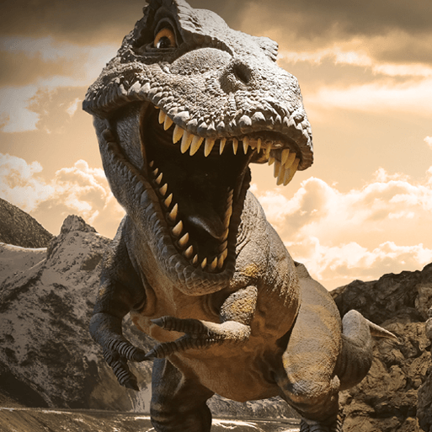





Dangerous Dinosaurs
Pegasus Class
Spring Term February 2026
Characteristics of Learning
As Investigative Learners we will explore and experience things, and ‘have a go’.
As Active Learners we will concentrate and keep on trying if we encounter difficulties and enjoy our achievements.
As Creative and Critical Thinkers we will formulate our own ideas and make links between ideas. We will develop our own strategies for doing things.
LITERACY
MATHEMATICS
Personal, Social and Emotional Development
Communication and Language
We will be using White Rose Mastery Guidance exploring the new topics: Length, Height and Time, Building 9 & 10 and Explore 3D Shapes.
Number
We will explore the representations of numbers 6-10.
We will compare numbers 6-10.
We will continue to develop our understanding that a number can be
made up from other numbers.
Shape, Space and Measure
We will compare heights using the words: taller, longer and shorter.
We will begin to measure time.
We will explore different 3D shapes and spot them in our environment.
At home you could….
- count objects around the house.
-compare the height of different objects using the words; taller, longer and shorter.
Reading-
Nursery children will explore alliteration and voice sounds.
Reception children will continue to develop their recognition of sounds; recapping Level 2 and continue to explore Level 3 diagraphs.
We will listen to a range of stories linked to dinosaurs including; Dear Dinosaur by Chae Strathie, Cave Baby by Julia Donaldson and Dinosaur Roar by Henrietta Stickland. We will also explore non-fiction books about dinosaurs.
Writing-
Mark making opportunities will be available inside and out. We will use our phonics knowledge to sound out words to create lists, write instructions and reports. We will continue to practise writing our name using the correct letter formation.
At home you could….
- share non-fiction books about dinosaurs.
- make marks using pencils, paint, chalk, water.
-Nursery: practise name writing using correct letter formation.
- Reception: write words using phonics knowledge.
This term we will work together to achieve goals, revisit the class rules to help a new dinosaur visitor and develop our skills to find solutions to conflicts. We will also think about similarities and differences between people and our own roles and responsibilities.
This term we will listen to others and make comments on things we have heard. We will share our thoughts and ideas and ask questions.
We will learn a variety of new vocabulary related to dinosaurs and use these words in our conversations with others.
Physical Development
Understanding of the World
This term we will develop our Gross Motor skills through access to the outside, using tricycles and climbing frames. In PE we will be working in teams and develop our gymnastic skills though different ways of moving and climbing.
We will continue to develop our Fine Motor skills through using a range of small tools and funky finger activities to help develop hand-eye co-ordination.
This term we will learn about different dinosaurs, their size and their fossils. We will have the opportunity to create maps of a dinosaur island.
Expressive Arts and Design
RE
SMSC
As part of our SMSC curriculum, children will participate in a variety of activities, including Pancake Day, World Wildlife Day, Red Nose Day and RE days.
This term we will develop our art skills through making dinosaurs using different shapes, bubble wrap and paper plates.
We will use our imagination in our role play area linked to our interests.
This term we will focus on the question: Who are Christians and what do they believe? We will focus on stories from the Bible that show what Christians believe and establish that Christians live all over the world.

