Slide 1
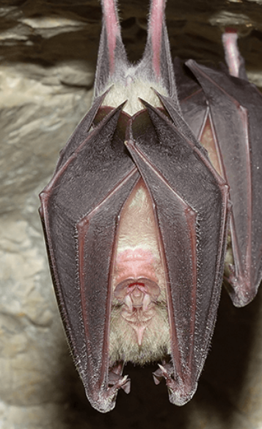



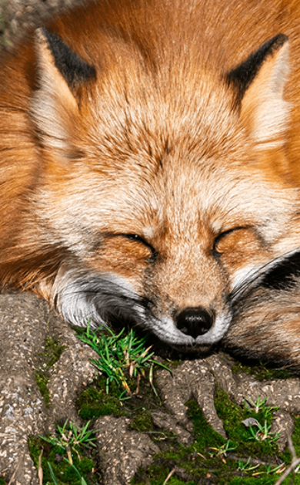





Starry Night
Pegasus Class
Spring Term January 2026
Characteristics of Learning
As Investigative Learners we will explore and experience things, and ‘have a go’.
As Active Learners we will concentrate and keep on trying if we encounter difficulties and enjoy our achievements.
As Creative and Critical Thinkers we will formulate our own ideas and make links between ideas. We will develop our own strategies for doing things.
LITERACY
MATHEMATICS
Personal, Social and Emotional Development
Communication and Language
Reading-
Nursery children will explore body percussion and rhythm and rhyme.
Reception children will continue to develop their recognition of sounds.
We will listen to a range of stories linked to nighttime including; Whatever Next by Jill Murphy and Owl Babies by Martin Waddell. We will sing songs and share rhymes.
Writing-
There will be opportunities for mark making inside and out. We will use our phonics knowledge to sound out words for speech bubbles We will create a space diary and write facts about a nocturnal animal. We will continue to practise writing our name or first initial using the correct letter formation.
At home you could….
- share stories linked to nighttime
- make marks using pencils, paint, chalk, water
- write words using phonics knowledge
- practise name writing using correct letter formation.
This term we will continue to use the White Rose Mastery Guidance.
Number
We will explore the representations of numbers 1-5 and beyond
We will compare numbers 1-5
We will understand that a number can be made up from other numbers
Shape, Space and Measure
We will be comparing different shapes with 4 sides
We will compare mass using the words heavier and lighter
We will explore capacity using the words full and empty
We will begin to measure ingredients
At home you could….
- count objects up to five and beyond around the house
- do some baking and measure the ingredients
This term we will think about characters’ feelings and discuss basic hygiene needs linked to cleaning teeth. We will learn how to take turns when playing games and how to work together to complete a challenge.
This term we will listen to others and make comments on things we have heard. We will share our thoughts and ideas and ask questions.
We will share our own explanations as to why things might happen.
Understanding of the World
Physical Development
This term we will find out about nocturnal animals, and people who work at night. We will explore why it gets dark at night. We will learn about the first astronauts on the moon.
This term we will develop our Gross Motor skills through open access to the outside using tricycles and climbing frames. In PE we will moving in different ways to music and developing our ball skills. We will develop our Fine Motor skills through the use of a range of small tools and funky finger activities to help develop hand-eye co-ordination.
Expressive Arts and Design
RE
SMSC
This term we will develop our art skills through creating silhouette pictures, collages and models of a variety of nocturnal animals. We will learn about the artist George Seurat; creating our own star using Pointillism.
We will use our imagination in our role play area linked to our interests.
As part of our SMSC curriculum, children will participate in a variety of activities, including Safer Internet Day, National Storytelling Week and RE days.
We will think about the question: What is the church and who goes there? We will learn about the reasons Christians go to church as well as Christian symbols and what they mean when used in church.

