Slide 1
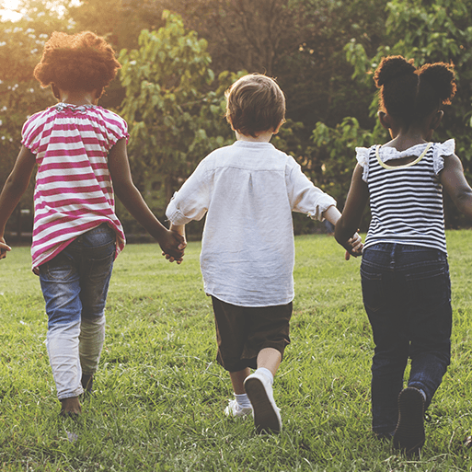
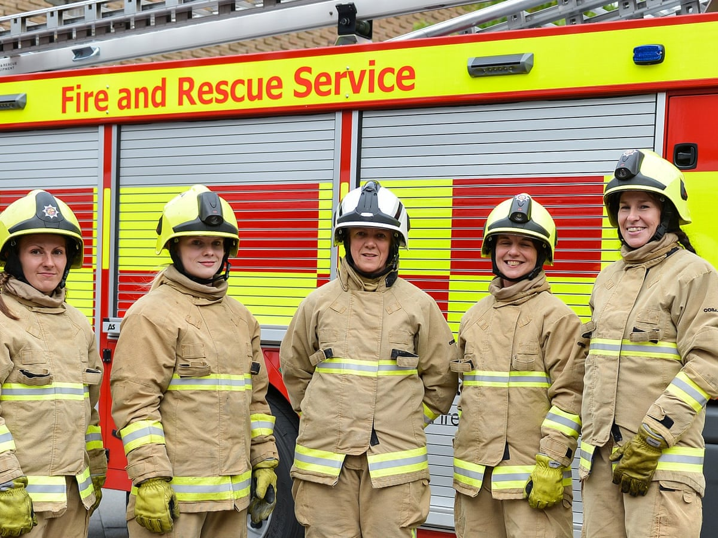
Me and My Community
Pegasus Class
Autumn Term September 2025
Characteristics of Learning
As investigative learners we will explore and experience things, and ‘have a go.’
As active learners we will concentrate and keep on trying if we encounter difficulties and enjoy our achievements.
As creative and critical thinkers we will have and develop our own ideas, make links between ideas, and develop our own strategies for doing things.
LITERACY
MATHEMATICS
Personal, social and emotional development
Communication and Language
Reading- we shall use our phonics scheme to develop our speaking and listening skills before starting to work on initial sounds.
We will listen to a range of stories with a theme of people from the community, sing songs and share rhymes.
Writing- there will be opportunities for mark making inside and out. We will use our phonics knowledge to sound out words for captions, labelling pictures, writing labels for the environment and writing lists for tasks. We will learn to write our name or first initial using the correct letter formation.
At home you could….
-share stories together
-retell favourite stories
-make marks using pencils, paint, chalk
-practice name writing using correct letter formation
This term we will be using White Rose mastery guidance. We will begin the term by singing number songs, learning keys times of the day and using positional language to learn where things belong.
Then explore the topic ‘Match, Sort, Compare’ and ‘Talk about Measure an Pattern’ looking at:
Number
-matching and sorting
-comparing amounts
Shape, Space and Measure
-comparing size, mass and capacity
-exploring pattern
At home you could….
-sing nursery rhymes
-count objects around the house
-paint patterns using potatoes or fingers
This term we will focus on:-
-making friends, sharing and taking turns
-learning the routines of the day
-knowing about ourselves and our feelings
This term we will focus on:-
-talking about ourselves
-listening to others
-asking questions
Understanding of the World
Physical Development
This term we will focus on:-
-exploring the school community, meeting people around the school
-talking about changes we have made as we have grown up
-talking about people in the community and those who help us
This term we will focus on:-
Gross Motor- accessing outside for play on bikes, tricycles climbing frames and completing obstacle courses
Fine Motor- using a range of small tools and funky finger activities to develop fine motor control
SMSC
Expressive Arts and Design
RE
As part of our SMSC curriculum, children will participate in a variety of activities, including harvest festival, forest school, Black History Month, Children in Need and RE days.
We will develop our art skills by exploring a variety of paints, printing and collage.
We will use our imagination in our role play area and other activities linked to the childrens’ interests.
We will think about the question: Who are Christians and what do they believe? We will learn about Jesus and some of his teachings and explore Christianity around the world.
We will also learn about the Harvest festival and Rosh Hashanah.

