Slide 1
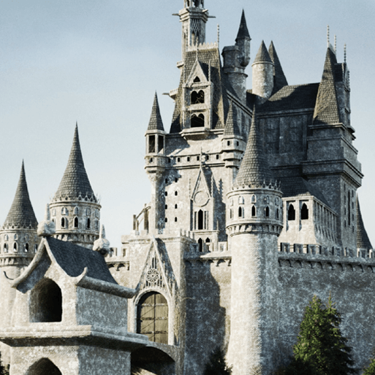
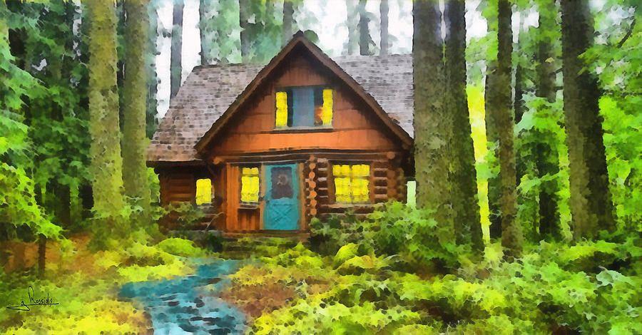
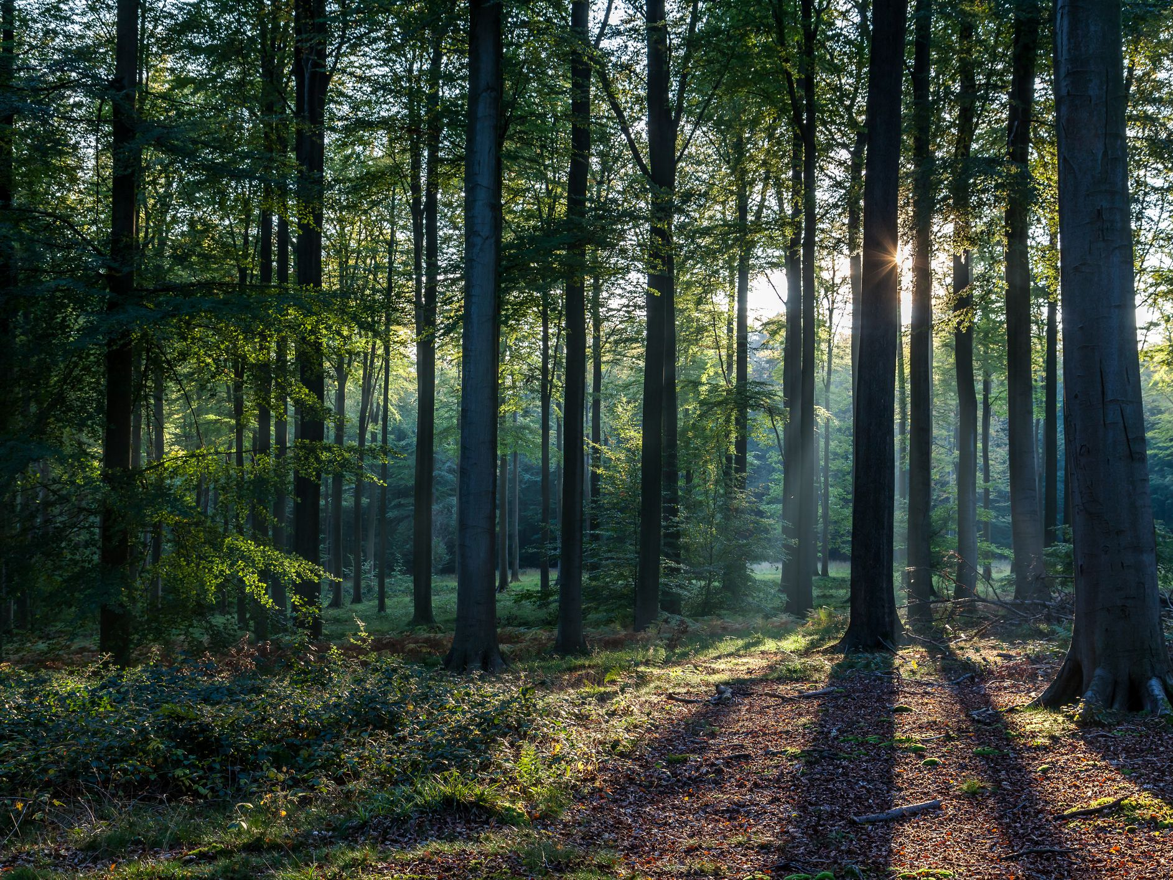





Once Upon a Time
Pegasus Class
Autumn Term November 2025
Characteristics of Learning
As Investigative Learners we will explore and experience things, and ‘have a go.’
As Active Learners we will concentrate and keep on trying if we encounter difficulties and enjoy our achievements.
As Creative and Critical Thinkers we will have and develop our own ideas, make links between ideas, and develop our own strategies for doing things.
LITERACY
MATHEMATICS
Personal, Social and Emotional Development
Communication and Language
Reading- we shall use our phonics scheme.
Nursery children will explore instrumental sounds and body percussion.
Reception children will continue to develop their recognition of sounds.
We will listen to a range of familiar and traditional tales, sing songs and share rhymes.
Writing- there will be opportunities for mark making inside and out. We will use our phonics knowledge to sound out words for speech bubbles, wanted posters and magic spells.
We will continue to practise writing our name or first initial using the correct letter formation.
At home you could….
-share stories together
-retell traditional tales
-make marks using pencils, paint, chalk
-practise name writing using correct letter formation
This term we will be using White Rose Mastery Guidance exploring the topics: ‘It’s Me 1, 2, 3!’ and ‘Circles and Triangles.’
Number
-exploring the representations of numbers 1-4
-comparing numbers 1-4
-understanding that a number can be made up from other numbers
Shape, Space and Measure
-exploring circles and triangles
-finding shapes in the environment
-using positional language to describe where an item is
At home you could….
-count objects up to four around the house
-go on a shape hunt
This term we will focus on:-
-taking turns when playing games
-thinking about characters’ feelings
-working together to complete a challenge
This term we will focus on:-
-listening to others
-sharing our thoughts and ideas
-asking questions
Understanding of the World
Physical Development
This term we will focus on:-
-comparing kings and queens from the past and those in fairytales
-exploring different materials to find the most suitable for an outfit
-comparing materials from today and the past
This term we will:
Gross Motor- have open access to the outside for exploration of tricycles, climbing frames. In PE we will move in a variety of different ways.
Fine Motor- use a range of small tools and funky finger activities to help develop hand-eye co-ordination.
Expressive Arts and Design
RE
SMSC
We will develop our art skills through exploring collages, painting and printing. We will learn about the artist Paul Klee; creating our own block print castles.
We will use our imagination in our role play area linked to our interests.
We will think about the question; ‘What do people celebrate and why?’
We will think about different celebrations from around the world and what significance they have for the people who celebrate them.
As part of our SMSC curriculum, children will participate in a variety of activities, including intra house sports competitions, RE days and Children in Need.

