Slide 1
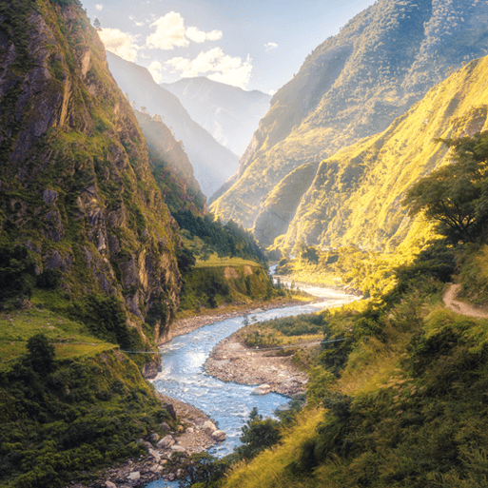
Misty Mountain, Winding River
Years 3 & 4
Summer Term 1
May ‘25
TOPIC OVERVIEW
As Geographers, we will look at the different aspects of a river, both natural and man-made and name features of them. We will also look at changes in rivers and eco-systems that live there. We will then investigate mountain ranges of the world, their topography and contour lines.
As Scientists, we will investigate the water cycle and how natural geography may have an impact on the water cycle. This will lead into investigating different states of matter and how they can change. We will also use our grouping and classifying skills when we investigate animals that live by or in the rivers.
As Design Technologists, we will design and make simple models and review the key features of mountains, rivers and the water cycle.
ENGLISH
Diaries: We will be looking at creating a diary entry for a boat trip
Leaflets: We will create a leaflet as a guide to hill-walking
Explanation text: We will write a text explaining the Water Cycle
Narrative Poetry: We will write a narrative poem about a mountain expedition
Class text: This Morning I Met A Whale by Michael Morpurgo.
The Mountain of Adventure by Enid Blyton
How you can help at home:
Ensure homework is completed
Discuss newly learnt words (spellings)
Encourage your child to read
MATHEMATICS
Children will be taught key aspects of the following:
Addition
Subtraction
Multiplication
Division
Fractions
Money (Year 3)
Decimals (Year 4)
How you can help at home:
Ensure your child completes their maths homework book weekly
Practise their times tables
RE
PSHE
What role does worship play in the
life of a Hindu?
We will be looking at worship at home and in the Mandir, pupils will explore arti and puja.
Identity, society and equality :
We will learn about Britain as a
democratic society, how laws are
made and learn about the local
Councils.
E-SAFETY & COMPUTING
Audio production:
We will learn about the devices needed to record sound and will use Audacity to capture and edit audio to produce a podcast, ensuring that copyright is considered.
MUSIC
Music:
Our theme for music this half term is Rivers. We will be looking at changes in pitch, tempo and dynamics
We will compare and
contrast animals in art.
We will sketch drawings of animals. We will discuss different animal coverings in terms of colour, pattern and texture and use printing techniques to create animal prints. We will learn about the Bankura horses of Panchmura and using clay create own version of a terracotta horse.
ART
SMSC
PE
Weather and the Water Cycle
We will learn how to ask about the weather and how to reply. We will also learn the compass points and the temperatures in celsius.
FRENCH
Events in school to support our SMSC development will include; RE day, VE Day, Pupil Voice, Mental Health week activities.
Dance & Swimming
In dance, we will be composing a sequence of movements with partners that involves remembering moves and translating ideas.
We will be swimming at Brize Norton, improving our swimming skills.
SMSC

