Slide 1
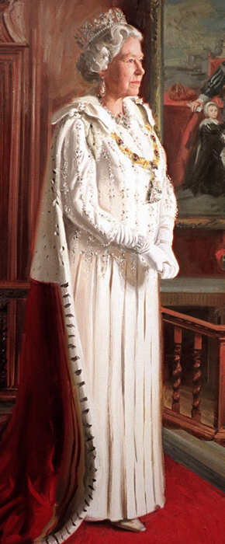
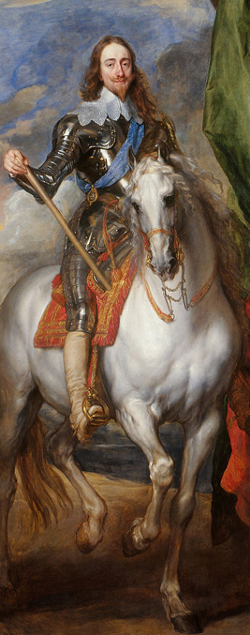
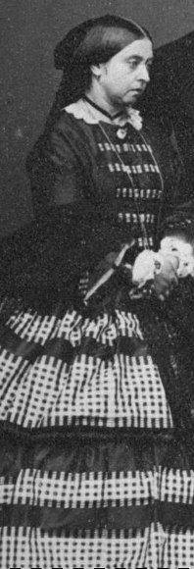





Magnificent Monarchs
Unicorn Class
Summer Term 1
April 2026
TOPIC OVERVIEW
As Geographers, we will learn about the Royal residences and their locations within the United Kingdom.
As Historians, we will learn about monarchs past and present, using timelines to discover when in history they reigned.
As Design Technologists, we will be exploring home products made from fabric and the significant British brand Cath Kidston. We will learn about sewing patterns and using a running stitch and embellishments before creating our own bag tag.
As Scientists, we will explore growth in animals by exploring the life cycles of some familiar animals. We will build on learning about the survival of humans by identifying the basic needs of animals for survival, including food, water, air and shelter.
ENGLISH
MATHEMATICS
Information Leaflets Following our learning about a monarch we will create our own information leaflet.
Poems
We will listen, perform and write our own poems based on an original.
How you can help at home:
Ensure homework is completed.
Read regularly at home together.
Support your child to learn their spellings.
Encourage writing experiences where possible.
Children will be taught key aspects of the following:
Year 1:
-Fractions
-Position and Direction
-Place Value within 100
Year 2:
-Fractions
-Time
-Mass, capacity and Temperature
How you can help at home:
Ensure your child completes their homework every week
Support your child to learn their number bonds to 10/100
Practise counting in 2s, 5s and 10s
Explore the app One Minute Maths to develop your child’s quick recall.
RE
PSHE
How and why is Shabbat
important to some Jewish people in Britain?
We will discover the celebration of Shabbat, exploring the origins and the practices associated with it.
Me and Others
We will begin by thinking about ourselves and our similarities and differences in relation to others. We will learn how we can be responsible and co-operative.
E-SAFETY & COMPUTING
MUSIC
In Computing we will be exploring digital photography using different devices to capture photographs, then edit and improve the photos that we have taken.
Pitch: Superheroes
We will learn how to identify high and low notes and to compose a simple tune to represent a superhero.
Striking and Fielding and Forest
School.
We will be exploring ball related skills including; rolling, throwing, catching and striking. In forest school, we will be exploring and creating in the natural world.
ART
PE
SMSC
We will continue our Flower
Head topic from last term, exploring colour, pattern and texture. Then we will create artwork of castles using different media.
As part of our SMSC curriculum, children will participate in a variety of activities including RE Day, forest school, and St George’s Day.

