Slide 1
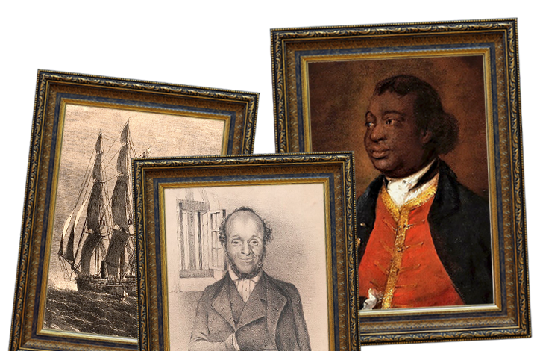





Maafa
Years 5 & 6
Summer Term
November 2026
TOPIC OVERVIEW
As Historians, we’ll find out about the growth and development of the transatlantic slave trade and the role that Britain played in it. We’ll explore the causes and consequences of the European colonisation of Africa and the worldwide communities that make up the African diaspora.
As Geographers, we’ll use various information sources to learn about the human and physical features that make up the continent of Africa. We’ll explore the number and size of its countries, natural resources, location, population, climate and physical geography.
As Scientists, we’ll investigate the transport role of the human circulatory system, its main parts and their primary functions. We’ll learn about healthy lifestyle choices and the effects of harmful substances on the human body.
ENGLISH
Newspaper reports: we will investigate the Slave Trade and write a newspaper report about an aspect of it
Persuasive letters: using the abolition of slavery as our topic, we will write persuasive letters
Non-chronological reports: we will use our historical knowledge of the Windrush scandal to write a report
Poetry: we will write poems about diversity
Class text: Windrush Child by Benjamin Zephaniah.
How you can help at home:
Ensure homework is completed.
Discuss newly learnt words (spellings)
Encourage your child to read.
MATHEMATICS
Children will be taught key aspects of the following:
Shape
Statistics
Position & Direction
Area, Perimeter & Volume
How you can help at home:
Ensure homework is completed.
RE
PSHE
How far does the mosque contribute to the Muslim concept of Ummah? Understanding the worldwide community of Islam, and the role of the mosque. Explore other ways that ummah is expressed.
Identity, society and democracy stereotypes, discrimination and prejudice (including tackling homophobia.)
Pupils learn about prejudice and discrimination and how this can make people feel.
E-SAFETY & COMPUTING
MUSIC
Compositions for the Festival of Colour
We will explore composing music for pictures and colours as well as working as a group to perform.
In E-safety we will explore the importance of on-line safety including privacy and security.
In Computing we will explore how to use a computer to produce 3D models.
SMSC
ART
PE
FRENCH
Cultural development
We will explore cultural influences and discuss how we can understand, accept, respect and celebrate diversity. We will then link this to the way we learn and develop our knowledge as individuals.
Trailblazers, barrier breakers
We will learn about significant black artists and their work. Children will then have the opportunity to analyse and create artwork inspired by them.
PE
We’ll develop our racquet skills through playing tennis and learn the rules. We’ll also take part in gymnastic activities focusing on balance.
Our surroundings
Children will be taught to speak with increasing confidence, fluency and spontaneity. Topics for this term include: la plage, le temps et les vacances.

