Slide 1
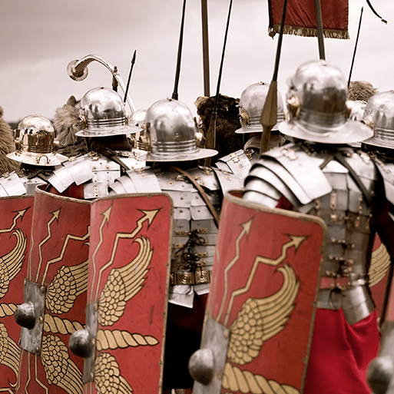





Emperors and Empires
Years 3&4
Summer Term
1
TOPIC OVERVIEW
As Historians, We will look at how the Roman Empire started and what made the Roman Army so great. We will research some of the famous Romans such as Cleopatra, Julius Caesar and famous celts such as Boudicca. Finally, we will learn about what the what the Romans did for us.
As Geographers, we will learn how far the Roman Empire spread and look at the planning of a Roman town.
As Scientists, we will learn about the requirements of plants for growth and survival, describe the parts of flowering plants and relate structure to function, including the roots and stem for transporting water, leaves for making food and the flower for reproduction.
We will also learn about light and dark. We will investigate the phenomena of reflections and shadows, looking for patterns in collected data. The risks associated with the Sun are also explored.
As Design Technologists, we will create our own weavings.
ENGLISH
MATHEMATICS
Biographies: We will be writing a biography on one of the most famous Romans – Julius Caesar
Myths: We will write a myth based on some of the Roman Gods
Letters: We will be writing letters to our families back in Rome from Hadrian’s Wall.
Class text: The Thieves of Ostia by Roman Mysteries
Poetry – We will be writing poetry, learning and then using rhyming couplets
How you can help at home:
Ensure homework is completed
Discuss newly learnt words (spellings)
Encourage your child to read
Children will be taught key aspects of the following:
Fractions
Time
Mass and capacity
Shape
Decimals
Position and direction
How you can help at home:
Ensure your children completes their homework books each week.
RE
PSHE
What is the Qur’an and why do many Muslims try to learn it by heart?
We will be looking at how Angel Jibril dictated the very words of God; therefore how important these are to a Muslim.
Identity, society and equality
We will be celebrating difference between each other. We will look at the different communities that we belong to and why we like to be a part of them.
Photo Editing
We will learn how to manipulate digital
images, and reflecting on the impact of the
changes and whether the required purpose is fulfilled,
E-SAFETY & COMPUTING
Music
We will look at the adapting and transposing musical motifs (repeated patterns) around the theme of the Romans. This will lead to a composition of different versions of a motif.
MUSIC
ART
Artists and Techniques
We will learn about the genre of botanical art. We will create natural weavings, two-colour prints and beautiful and detailed botanical paintings of fruit. We will also design our own mosaics.
PE
Bon Appetite!
We will be looking at the words for some everyday French foods, and buying them in a French market. We will also learn how to say I like … or I don’t like …
SMSC
Games-Striking and Fielding
& Swimming
In games we will learning skills in cricket and rounders.
We will be swimming at Brize Norton, improving our swimming skills.
FRENCH
Events in school to support our
SMSC development will include; RE day, Pupil Voice, etc.

