Slide 1
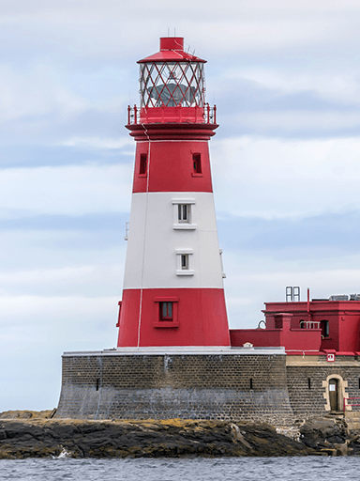





Coastlines
Unicorn Class
Spring Term 2
February 2026
TOPIC OVERVIEW
As Geographers we will learn about the locations of the five oceans in the world using maps and atlases, whilst exploring keys and compasses. We will explore human and physical features of a coastal town.
As Historians, we will learn about the famous sea explorer; Captain James Cook. We will also explore the coastal town of Whitby and how it has changed since 1760.
As Design Technologists, we will be exploring human features around the coast including; lighthouses, boats and ships then using construction kits to build these.
As Scientists we will explore the words floating and sinking before carrying out an experiment to explore items which float and sink, then group them accordingly.
ENGLISH
Narrative: After exploring a story, we will create our own based on the original.
Non-Chronological Report: Following our learning about a coastal town we will create our own non-chronological report based on the coastal town.
Poems: We will listen, perform and write our own seaside poems based on the original.
How you can help at home:
Ensure homework is completed
Read regularly at home together
Support your child to learn their spellings
Encourage writing experiences where possible
MATHEMATICS
Children will be taught key aspects of the following:
Year 1:
-Mass & Volume
-Multiplication & Division
-Fractions
Year 2:
-Multiplication & Division
-Length and Height
How you can help at home:
Ensure your child completes their CGP books every week
Support your child to learn their number bonds to 10/100
Practice counting in 2s, 5s and 10s
Explore the app One Minute Maths to develop your child’s quick recall
What do different Jewish people believe about God?
We will learn about God as creator and the choosing of Abraham. We will also explore the religion of Judaism.
RE
Drug, alcohol and tobacco education
We will consider what can go onto and into our bodies safely and how it makes us feel. We will learn how to identify substances that we might find at home or school that are good and not so good for our bodies.
PSHE
E-SAFETY & COMPUTING
MUSIC
In Computing we will be exploring information technology at school and beyond. We will investigate how information technology improves our world, and learn about using information technology responsibly.
Musical Symbols: Under the Sea
We will combine all the musical concepts we have learned so far in an underwater-themed performance incorporating instrumental, vocal and body sounds.
ART
PE
SMSC
We will be looking at the visual elements of flowers including shape, texture, colour, pattern and form. We will create artwork inspired by the artists Dave Chihuly, Takashi Murakami and Yayoi Kusama.
Orienteering and Gymnastics
In orienteering we will explore compasses and where we are on a map.
Within gymnastics we will be exploring a range of balances and developing our ability to hold a balance.
As part of our SMSC curriculum, children will participate in a variety of activities including RE Day, World Book Day, Mother’s Day, Easter.

