Slide 1
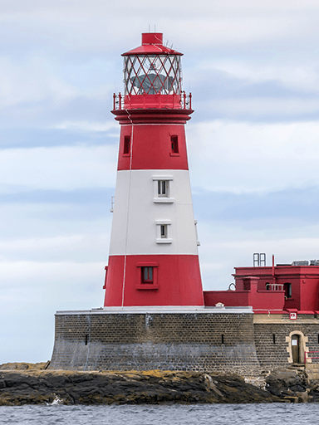





Coastlines
Unicorn Class
Spring Term 1
January 2026
TOPIC OVERVIEW
As Geographers we will learn about the locations of the five oceans in the world using maps and atlases, whilst exploring keys and compasses. We will explore human and physical features of a coastal town.
As Historians, we will learn about the famous sea explorer; Captain James Cook. We will also explore the coastal town of Whitby and how it has changed since 1760.
As Design Technologists, we will be exploring human features around the coast including; lighthouses, boats and ships then using construction kits to build these.
As Scientists we will explore the words floating and sinking before carrying out an experiment to explore items which float and sink, then group them accordingly.
ENGLISH
Descriptions: We will use adjectives to write a descriptive piece about a coastal town.
Narrative: After exploring a story, we will create our own based on the original.
Non-Chronological Report: Following our learning about a coastal town we will create our own non-chronological report based on the coastal town.
How you can help at home:
Ensure homework is completed
Read regularly at home together
Support your child to learn their spellings
Encourage writing experiences where possible
MATHEMATICS
Children will be taught key aspects of the following:
Year 1:
-Addition and Subtraction
-Place Value
Year 2:
Shape
Money
Multiplication & Division
How you can help at home:
Ensure your child completes their CGP books every week
Support your child to learn their number bonds to 10/100
Practice counting in 2s, 5s and 10s
Explore the app One Minute Maths to develop your child’s quick recall
What questions do stories in the Bible make us want to ask?
We will explore how stories in the Bible are open to different interpretations. It will allow us to wonder and ask questions.
RE
Mental Health and Emotional
Wellbeing: Feelings
We will learn to recognise different feelings and how they look and feel within the body. We will think about how we manage these feelings and how people may feel differently about the same situation.
PSHE
E-SAFETY & COMPUTING
MUSIC
In Computing we will be moving a robot. We will write short algorithms and program floor robots and predict the program outcomes.
Dynamics: Seaside
We will make links between music, sounds and the environment. We will use percussion, vocal and body sounds to represent calm or stormy seas.
H.R.E and Football
In Health-Related Exercise (HRE)
children will explore how their body changes during different levels of intensity. In football children will learn how to keep a ball close and under control and pass and shoot effectively.
ART
PE
SMSC
We will use the coastline theme to develop our skills in painting, collage and drawing through activities including; treasure maps, seahorse designs and jellyfish.
As part of our SMSC curriculum, children will participate in a variety of activities including RE Day, Safer Internet Day and National Story Telling Week.

